Slide 1
Bit Rates for Digital Television
The bit rate for digital television depends very much on the picture format such as high definition TV (HDTV) and standard definition TV (SDTV).
For example 16 bits per pixel gives a color depth of 2¹⁶ = 65536 colors
A single DBS transponder has to carry somewhere between four and
eight TV programs to be commercially viable
The programs may originate from a variety of sources, for example film, analog TV, and videocassette.
Before transmission, these must all be converted to digital, compressed, and then time-division multiplexed (TDM). This TDM baseband signal is applied as QPSK modulation to the uplink carrie reaching a given transponder.

Slide 2
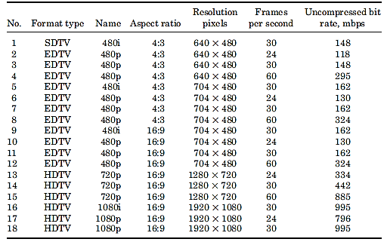


Slide 3
MPEG Compression Standards
MPEG stands for Moving Pictures Expert Group, a group within the International Standards Organization and the International Electrochemical Commission (ISO/IEC) that undertook the job of defining standards for the transmission and storage of moving pictures and sound.
MPEG standards currently available are
MPEG-1,
MPEG-2,
MEPG-4, and
MPEG-7.
In DBS Systems
MPEG-1 : Audio Compression
MPEG-2 : Video compression

Slide 4
MPEG1 Compression Standards (MPEG1 )
MPEG-1 is the designation for a group of audio and video coding standards agreed upon by MPEG (Moving Pictures Experts Group). MPEG-1 video is used by the Video CD format. The output quality at usual VCD bit rates is roughly that of a VCR.MPEG-1 audio layer 3 is the full name for the popular audio format MP3. en.wikipedia.org/wiki/MPEG1

Slide 5


In DBS systems, MPEG-1 is used for audio compression
MPEG-1 audio supports mono and two channel stereo only
The need for audio compression
It can be seen by considering the bit rate required for high-quality audio.
The bit rate is equal to the number of samples per second (the sampling frequency fs) multiplied by the number of bits per sample n:
For a stereo CD recording, the sampling frequency is 44.1 kHz, and the number of bits per sample is 16:
This bit rate, approximately 1.4 Mb/s, represents too high a fraction of the total bit rate allowance per channel, and hence the need for audio compression

Slide 6
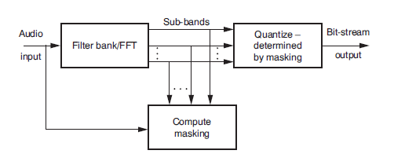
MPEG-1 block schematic
The filter bank divides the spectrum of incoming signal into spectrum
The spectrum is analysed for masking levels.
The masking information is passed to quantizer
The quantizer quantizes the subbands based on noise factor

Slide 7
MPEG2 Compression Standards (MPEG2)(1/2)
MPEG2 is a second set of flexible compression standards created by the MPEG group. This set of standards takes advantage of the fact that over 95% of digital video is redundant, however some portions are much less redundant. MPEG2 handles this by using higher bit rates (i.e. higher quality) for more complex pictures and lower bit rates for simple pictures
MPEG2 is a form of compression used to compress all pictures onto a DVD.
The digital video signal compression standard used for DVD. This adaptive, variable bit-rate process is able to allocate more bits for complex scenes involving a lot of motion, while minimizing the bits in static scenes. The average data rate for DVD is 3.5 Mbps (million bits/second). www.filmfodder.com/movies/dvd/glossary/glossary.htm

Slide 8
MPEG2 Compression Standards (MPEG2)(2/2)
MPEG2 is an abbreviation for the Moving Picture Experts Group, working committee of experts. MPEG2 is a higher ranking standard of MPEG1 which was adopted in 1991 as the standard for CD-ROM. MPEG2 was adopted in 1994 as the universal picture coding system for broadcasting and communications as well as for storage media such as optical disc. MPEG2 multi-channel audio is one of the digital surround sound system available on DVD discs, another option for Dolby® Digital.
MPEG-2 (1994) is the designation for a group of audio and video coding standards agreed upon by MPEG (Moving Pictures Experts Group), and published as the ISO/IEC 13818 international standard. MPEG-2 is typically used to encode audio and video for broadcast signals, including direct broadcast satellite and Cable TV. MPEG-2, with some modifications, is also the coding format used by standard commercial DVD movies. en.wikipedia.org/wiki/MPEG2

Slide 9

As a first in preprocessing step, the analog outputs from the red (R), green (G), and blue (B) color cameras are converted to a luminance component (Y) and two chrominance components (Cr) and (Cb).

Slide 10
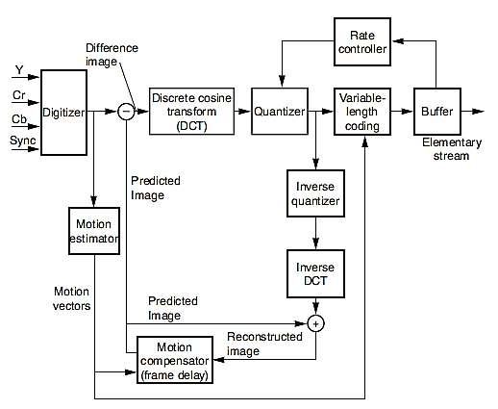

Slide 11
The Y, Cr, and Cb analog signals are sampled in the digitizer
It is an observed fact that the human eye is less sensitive to resolution in the color components (Cr and Cb) than the luminance (Y) component. This allows a lower sampling rate to be used for the color components. This is referred to as chroma subsampling
Sampling is usually indicated by the ratios Y:U:V
Y - the luminance (or luma) sampling rate
U - Cb sampling rate,
V- Cr sampling rate

Slide 12
The ratio Y:U:V is given by,
4:4:4 means that the sampling rates of Y, Cb, and Cr are equal. Each pixel would get three digital words, one for each of the component signals.
4:2:2 means that the Cb and Cr signals are sampled at half the rate of the Y signal component. Every two pixels would have two bytes for the Y signal, one byte for the Cb signal and one byte for the Cr signal, resulting in 4 bytes for the 2-pixel block.
4:2:0 means that Cb and Cr are sampled at half the Y sampling rate, but they are sampled only on alternate scan lines. Thus vertical as well as horizontal resolution is reduced by half

Slide 13
Discrete cosine transform (DCT)
It converts these to a “spatial frequency” domain.
In the DCT situation, the input signals are functions of the x (horizontal) and y (vertical) space coordinates, g(x, y).
The DCT transforms these into a domain of new variables u and v, G(u, v).
The variables are called spatial frequencies in analogy with the time-frequency transform.
It should be noted that g(x, y) and G(u, v) are discrete functions.

Slide 14
Quantizer
The discrete values of G(u, v) are quantized to predetermined levels. This reduces the number of levels to be transmitted and therefore provides compression
Motion Estimation
Compression is also achieved through motion estimation. This process leads to 3 Basic types of encoded output frames.
I frame
P grame
B frame

Slide 15
The I frame is an independent frame, meaning that it can be reconstructed without reference to any other frames.
P (for previous) frame is compared with the previous I frame, and only those parts differ then only that frame eed to be encoded.
B (for bidirectional) frame is compared with the previous I or P frame and with the next P frame. Only the resulting are encoded . This leads to further compression
Encoding and Decoding
Encoding process relies on digital decision-making circuitry and is computationally intensive and expensive
Decoding is carried out in the integrated receiver decoder (IRD) unit

Slide 16
MPEG4 Compression Standards (MPEG4 )(1/3)
Moving Picture Experts Group Compression Standard Version 4. MPEG4 is a technology for compressing voice, video and related control data and is one of the MPEG (Moving Picture Experts Group) international standards.
It is currently a focus of attention due to the fact that it enables high speed and stable video transmission even in heretofore difficult environments such as mobile communication. al video and digital audio compression.

Slide 17
MPEG4 Compression Standards (MPEG4 )(2/3)
(Moving Picture Experts Group) MPEG4 is the most recent version of a standard for the digital representation of video, audio and certain types of 3D information. It processes detailed 3D representation for faces, human bodies and general 3D scenes. The 3D scene representation points to the VRML standard as it's representation
Virtual Reality Modeling Language (VRML) is an Internet standard for the rendering of 3D graphics. VRML files can be viewed with plug-ins such as Live3D.
Virtual Reality Modeling Language. An open, extensible, industry-standard scene description language for 3-D scenes, or worlds, on the Internet. With VRML and certain software tools, you can create and view distributed, interactive 3-D worlds that are rich with text, images, animation, sound, music and video.

Slide 18
MPEG4 Compression Standards (MPEG4 )(3/3)
MPEG-4, introduced in late 1998, is the designation for a group of audio and video coding standards and related technology agreed upon by the ISO/IEC Moving Picture Experts Group (MPEG). The primary uses for the MPEG-4 standard are web (streaming media) and CD distribution, conversational (videophone), and broadcast television.

Slide 19
MPEG-4
MPEG-4 was developed jointly by the Video Coding Experts Group (VCEG) of the International Telecommunication Union (ITU), Telecommunication Standardization Sector (ITU-T) which uses the designation H.264, and the MPEG of the ISO/IEC.
Application
Video Telephony,
Video Storage And Retrieval (DVD And Hard Disk)
Digital Video Broadcast

Slide 20

As with MPEG-2 the analog outputs from the red (R), green (G), and blue (B) color cameras are converted to a luminance component (Y) and two chrominance components (Cr) and (Cb) but with a different M matrix
MPEG-4 provides many features as interactivity for viewers, where objects within a scene can be manipulated, but from the point of view of satellite television
Bit rate is very much reduced
As with MPEG-2, frames are compared for changes through comparing macroblocks of 16 x 16 pixels, but H.264/AVC also allows for comparisons of submacro blocks of pixel groups 16 x8, 8x16, 8x 8, 8x4, 4x8, and 4x4.

Slide 21
MPEG7 Compression Standards (MPEG7 )
Multimedia Content Description Interface standardizing descriptions for audio-visual content
MPEG-7 is a multimedia content description standard. Thus, it is not a standard which deals with the actual encoding of moving pictures and audio, like MPEG-1, MPEG-2 and MPEG-4. It uses XML to store metadata, and can be attached to time code in order to tag particular events, or synchronize lyrics to a song, for example.

Slide 22
Forward Error Correction
Need for FEC
Due to highly compressed nature of the DBS signal, there is little redundancy in the information being transmitted, and bit errors affect the signal much more severely than they would in a non compressed bit stream. As a result, FEC is a must.
The outer code - is a Reed-Solomon code that corrects for block errors, and the inner code is a convolution code that corrects for random errors.
The inner code – convolution code, that utilizes forward error correction (FEC), i.e. the Viterbi, Reed-Soloman, and Turbo Code decoding algorithms.
FEC bits add overhead to the bit stream.
Typically, for a 240 W transponder, the bit capacity of 40 Mbps may have a payload of 30 Mbps and coding overheads of 10 Mbps.
The low-power 120 W transponder require higher coding overheads to make up for the reduction in power and have a payload of 23 Mb/s and coding overheads of 17 Mbps.

Slide 23
The Home Receiver Outdoor Unit
The home receiver consists of two units, an outdoor unit and an indoor unit.
The downlink signal, covering the frequency range 12.2 to 12.7 GHz, is focused by the antenna into the receive horn.
The horn feeds into a polarizer that can be switched to pass either left-hand circular to right-hand circular polarized signals.
The low-noise block that follows the polarizer containers a low-noise amplifier (LNA) and a down converter.
The down converter converts the 12.2 to 12.7 GHz band to 950 to 1450 MHz.

Slide 24
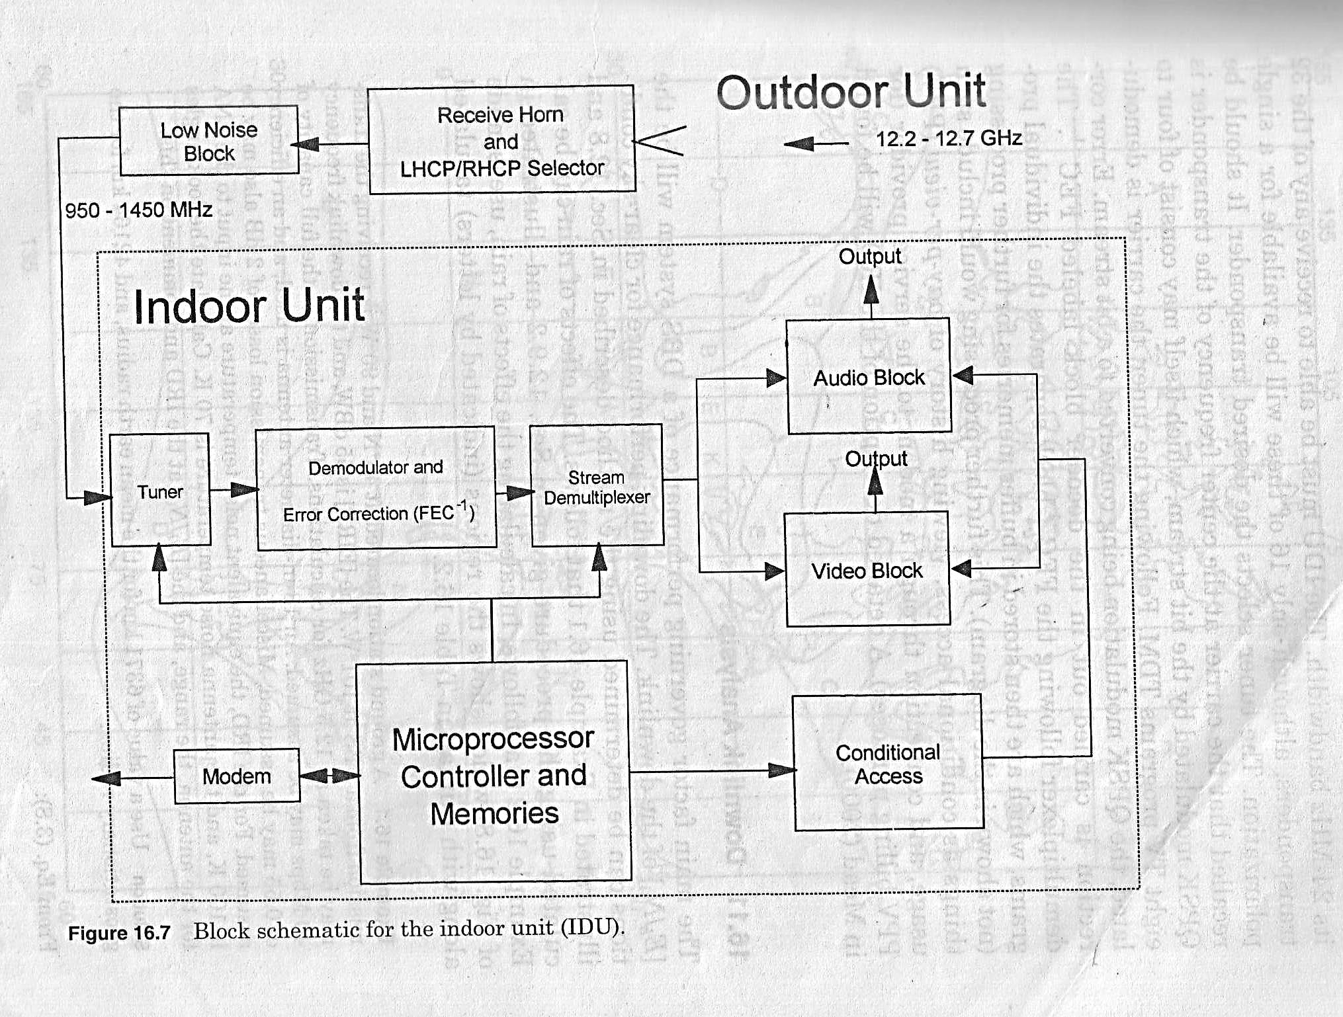
SCHEMATIC FOR INDOOR UNIT

Slide 25
Uplink Analysis
Sources of signals
The signals may originate from different sources
Analog TV signals from satellite broadcast
From studios
Processing
The received signal must undergo different process
Conversion into digital form
compression
TDM
Program guide and conditional access
FEC for QPSK modulation

Slide 26
Downlink Analysis
The main factor governing performance of a DBS system will be the
[Eb/N0] of the downlink. The downlink performance for clear-sky conditions can be determined using CNR
The effects of rain can be calculated. Under rain conditions, the antenna size must be found in such a way to give adequate signal.

